Slide 1
Linux File System

Slide 2
File Systems
What is the File System usually used with Windows?
Linux:
ext – Extended file system, designed for linux systems, obsolete
ext2 – 2nd revision extended file system, 32TB max volume
ext3 – Journaled version of ext2, same limits
ext4 – Designed for large file systems (up to 1 exbibyte), file sizes up to 16 tebibytes
Xfs – Developed by SGI, up to 16 exbibyte volume, up to 8EiB file size
What’s the difference between tebibyte and terabyte?

Slide 3
Filesystem Hierarchy Standard (FHS)
/ | Primary hierarchy root and root directory of the entire file system hierarchy.
/bin | Essential command binaries that need to be available in single user mode; for all users
/boot | Boot loader files, e.g., kernels, initrd.
/dev | Essential devices

Slide 4
Filesystem Hierarchy Standard (FHS)
/ | Primary hierarchy root and root directory of the entire file system hierarchy.
/etc | Host-specific system-wide configuration files
/home | Users' home directories, containing saved files, personal settings, etc.
/lib | Libraries essential for the binaries in /bin/ and /sbin/.

Slide 5
Filesystem Hierarchy Standard (FHS)
/ | Primary hierarchy root and root directory of the entire file system hierarchy.
/media | Mount points for removable media such as CD-ROMs (appeared in FHS-2.3).
/mnt | Temporarily mounted filesystems.
/opt | Optional application software packages

Slide 6
Filesystem Hierarchy Standard (FHS)
/ | Primary hierarchy root and root directory of the entire file system hierarchy.
/proc | Virtual filesystem providing process and kernel information as files. In Linux, corresponds to a procfs mount.
/root | Home directory for the root user.
/run | Run-time variable data: Information about the running system since last boot, e.g., currently logged-in users and running daemons.

Slide 7
Filesystem Hierarchy Standard (FHS)
/ | Primary hierarchy root and root directory of the entire file system hierarchy.
/sbin | Essential system binaries
/srv | Site-specific data which are served by the system.
/tmp | Temporary files (see also /var/tmp). Often not preserved between system reboots, and may be severely size restricted.

Slide 8
Filesystem Hierarchy Standard (FHS)
/ | Primary hierarchy root and root directory of the entire file system hierarchy.
/usr | Secondary hierarchy for read-only user data; contains the majority of (multi-)user utilities and applications.[
/var | Variable files—files whose content is expected to continually change during normal operation of the system—such as logs, spool files, and temporary e-mail files.

Slide 9
Physical vs. Logical
It all starts at /
Mountpoints
/etc/fstab

Slide 10
/etc/fstab
The file that makes the file system work…
fstab is a configuration file that contains information of all the partitions and storage devices connected to your computer. The file is located in /etc. You must be root to edit this file
<device> <mountpoint> <filesystemtype><options> <dump> <fsckorder>
/dev/hdb5 / ext2 defaults 1 1
/dev/hdb2 /home ext2 defaults 1 2

Slide 11
/ets/fstab
first field /dev/hdb5 is the physical device or remote filesystem to be mounted
second field / specifies the mount point where the filesystem will be mounted
third field is the type of filesystem on the device from the first field
fourth field (noauto, ro, user) is a (default) list of options which mount should use when mounting the filesystem
fifth field (0) is used to by dump (backup util) to decide if a filesystem should be backed up. If zero then dump will ignore that fs (1) means don’t ignore
sixth field if (0) the the filesystem will not be checked. 1 is file sys errors corrected, 2 is system should be rebooted

Slide 12
Fstab options
auto - Mount automatically at boot, or when the command mount -a is issued.
noauto - Mount only when you tell it to.
exec - Allow execution of binaries on the filesystem.
noexec - Disallow execution of binaries on the filesystem.
ro - Mount the filesystem read-only.
rw - Mount the filesystem read-write.
user - Allow any user to mount the filesystem. This automatically implies noexec, nosuid, nodev, unless overridden.
users - Allow any user in the users group to mount the filesystem.
nouser - Allow only root to mount the filesystem.
owner - Allow the owner of device to mount.
sync - I/O should be done synchronously.
async - I/O should be done asynchronously.
dev - Interpret block special devices on the filesystem.
nodev - Don't interpret block special devices on the filesystem.

Slide 13
Fstab options
suid - Allow the operation of suid, and sgid bits. They are mostly used to allow users on a computer system to execute binary executables with temporarily elevated privileges in order to perform a specific task.
nosuid - Block the operation of suid, and sgid bits.
noatime - Don't update inode access times on the filesystem. Can help performance (see atime options).
nodiratime - Do not update directory inode access times on the filesystem. Can help performance (see atime options).
relatime - Update inode access times relative to modify or change time. Access time is only updated if the previous access time was earlier than the current modify or change time. (Similar to noatime, but doesn't break mutt or other applications that need to know if a file has been read since the last time it was modified.) Can help performance (see atime options).

Slide 14
Fstab options
discard - Issue TRIM commands to the underlying block device when blocks are freed. Recommended to use if the filesystem is located on an SSD.
flush - The vfat option to flush data more often, thus making copy dialogs or progress bars to stay up until all data is written.
nofail - Mount device when present but ignore if absent. This prevents errors being reported at boot for removable media.
defaults - the default mount options for the filesystem to be used. The default options for ext4 are: rw, suid, dev, exec, auto, nouser, async.

Slide 15
LVM – Logical Volume Manager
Physical Volumes
Volume Groups
Logical Volumes
GUI (deprecated)
Command Line
https://www.tecmint.com/add-new-disks-using-lvm-to-linux/

Slide 16
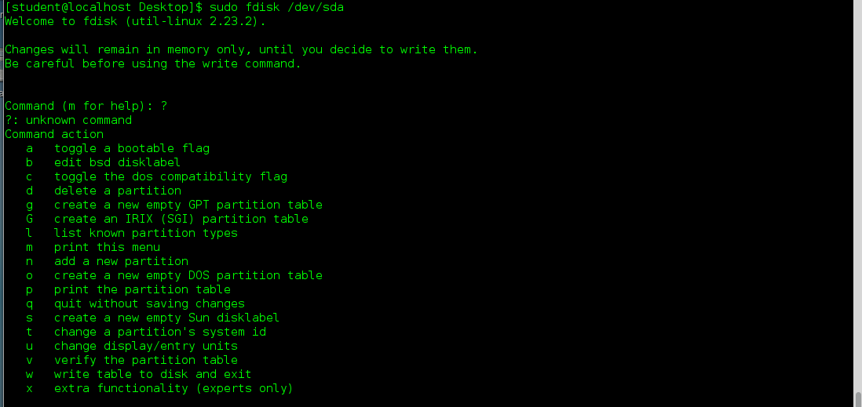
Adding a new disk
Fdisk is a command to manually configure disk partitioning, not used with LVM
Usually use commands p, n and w in fdisk

Slide 17
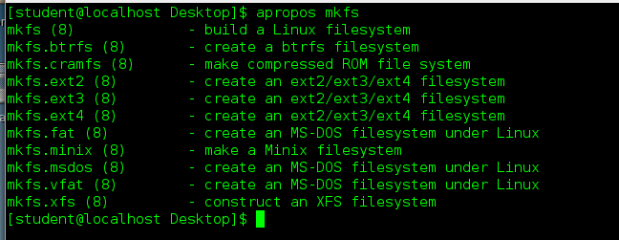
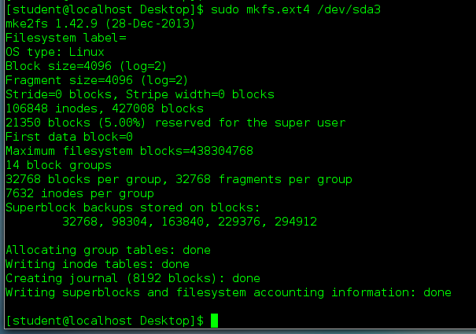
Creating a mountable partition
Use mkfs to take the raw partition created with fdisk and format it to be a mountable partition:

Slide 18
Manually mounting a partition
You can mount the disk and ensure it is in working order before adding it permanently to fstab
Mount /dev/sdb /mnt/disk
Umount /mnt/disk
Guide to disk add process:
https://www.tecmint.com/add-new-disk-to-an-existing-linux/

Slide 19

UUID vs. “text name”
UUID is consistent no matter what the logical name is
Best choice when using SAN or hot-pluggable (USB) disk

Slide 20
Lab Exercise – Disk Management
On your lab VM, follow the assignment instructions and create a new partition as instructed.

Slide 21

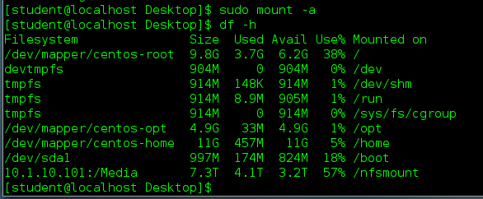
NFS
Network File System
Mounted somewhat like a local disk in /etc/fstab

Slide 22
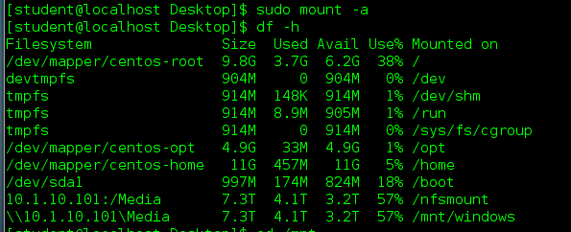
CIFS / SMB
Standard Windows file sharing
Need to make sure you have some support packages installed:
Add the entry to fstab (options to handle credentials):
And then run the mount command:

Slide 23
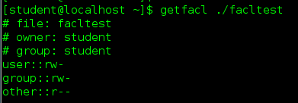
ACLs – Access Control
The way to add multiple groups/users is by using setfacl this will allow for Access Control Lists against files and directories
Add permissions to a user
setfacl -m "u:username:permissions”
Or
setfacl -m "u:uid:permissions”
Add permissions to a group
setfacl -m "g:groupname:permissions”
Or
setfacl -m "g:gid:permissions”

Slide 24
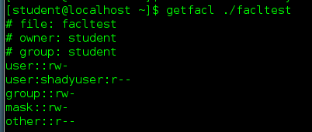
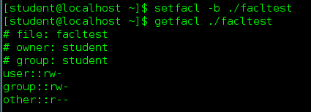
ACLs – Access Control
To remove all permissions
setfacl –b
To check permissions
getfacl filename
getfacl directoryname

Slide 25
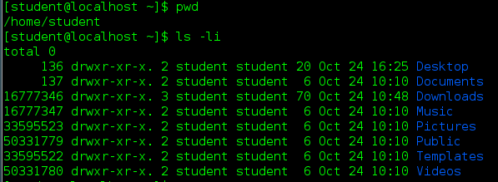
Inodes
What is an inode?
How can we see an inode number?

Slide 26

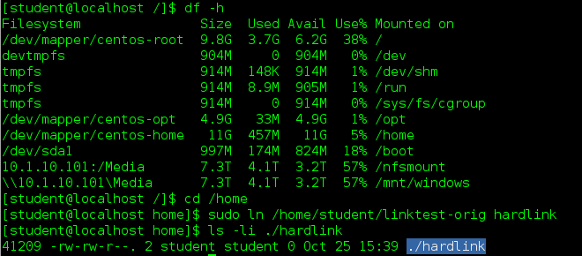
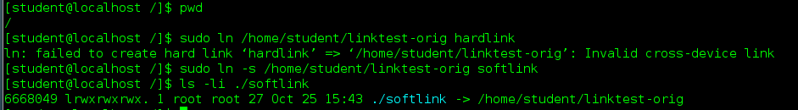
Links
Like shortcuts…
Hard link – must be on same physical partition, point to same inode
Symbolic link – like a Windows shortcut, a new “file” that points

